Slide 1

Restaurant Recommendation Using Yelp Reviews
Kausar Perveen | Sohan Puthran| Shouvik Sharma| Rahul Nair | Cheng Jiang

Slide 2
Agenda
1. Problem Statement
2. Data Preparation & Data Cleaning
3. EDA
4. Models
5. Lessons Learned and Future Plans
6. Deployment
7. Questions

Slide 3
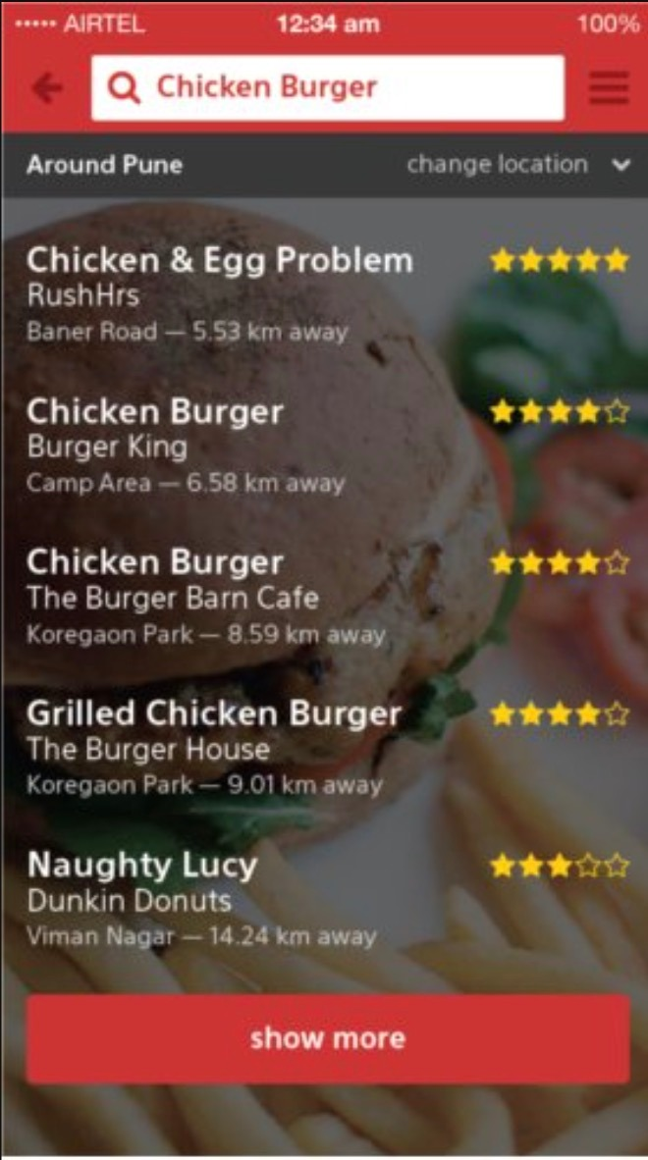
Problem & Vision
In terms of restaurants, there are too many options available for people to choose from based on their preferences.
It's always difficult for new visitors, even locals, to find the ideal restaurants that are exciting and novelty.
We aim to build a personalized prototype of restaurant recommendation system, which not only considers the interaction between customers and restaurants, but also contains metadata representing customers' personal taste and restaurant functions.

Slide 4
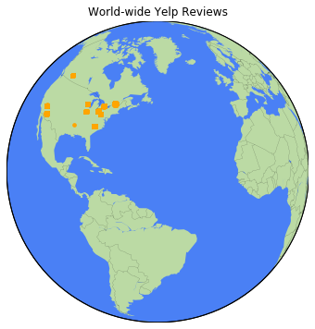
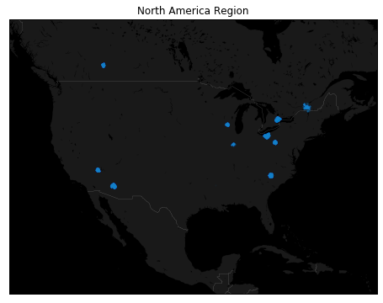
Project Goal

Slide 5
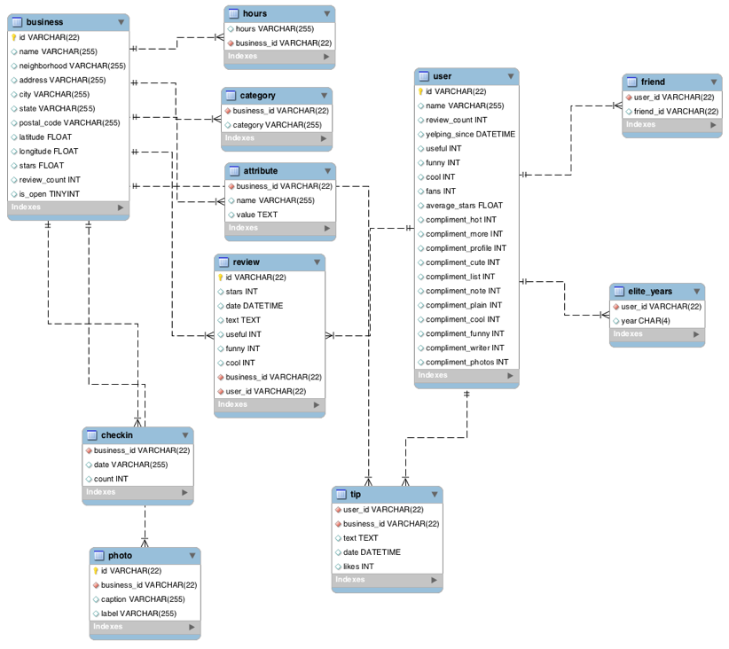
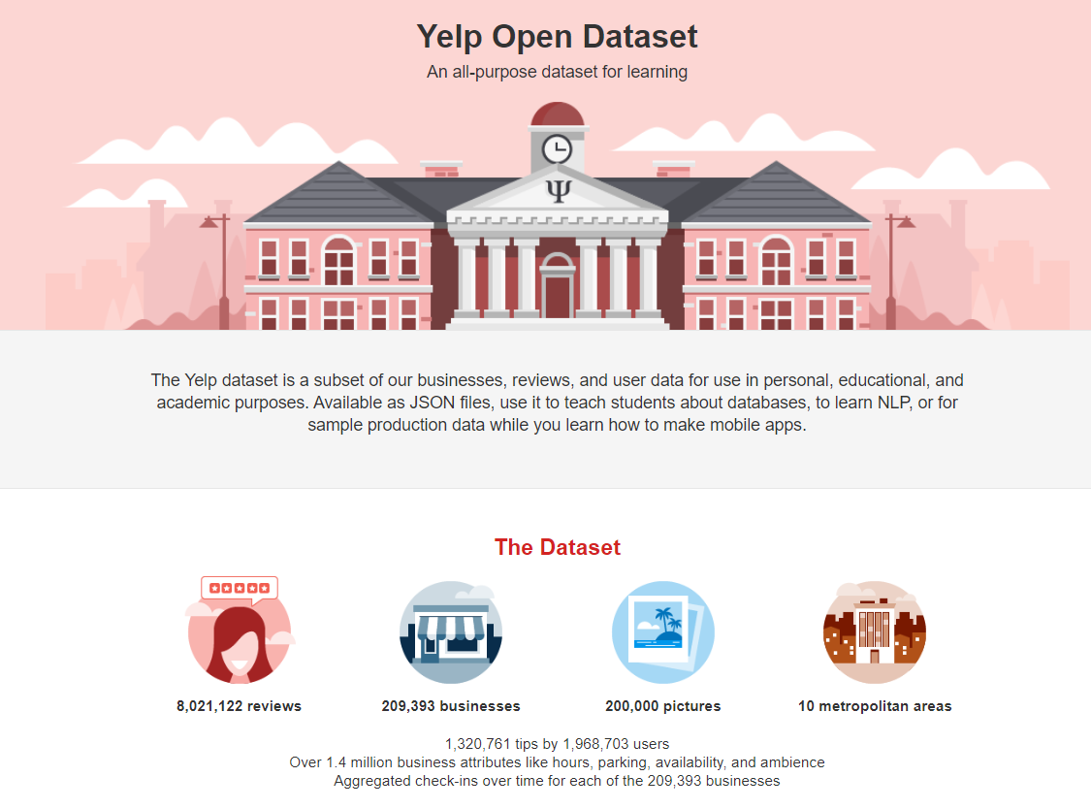
Datasets
Primary Dataset :-
Datasets are acquired from the official website of yelp
We are using following datasets :-
User.json
Review.json
Business.json
Secondary Dataset :-
We have acquired median income for each zipcode for the year 2019, and mapped to restaurants

Slide 6
Exploratory Data Analysis
Dataset Business contains geographical information about 192,609 businesses, categories and attributes, such as average star rating, hours, whether they offer parking etc.
Dataset review includes 6,685,900 review texts and ratings users write to businesses.
Dataset user includes information like how long ago the user has joined Yelp, the number of reviews he/she has written, the number of specific compliments received, and his/her friend mapping on Yelp about 1,637,138 users.
The three datasets can be merged by unique keys user_id and business_id.
Data was load using json library in python

Slide 7
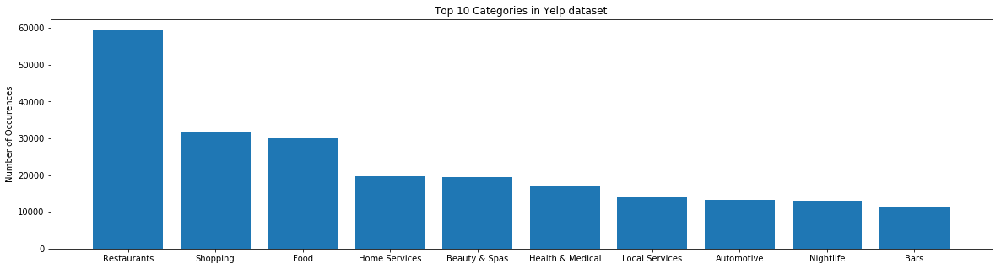
Exploratory Data Analysis
Business:
The yelp business dataset consists of variety of different businesses indicated by the column attributes
Number of entries for the category ‘Restaurants’ was the highest.
Notes:
Mention that ### There are 1301 categories. We shall check top 10 categories.

Slide 8
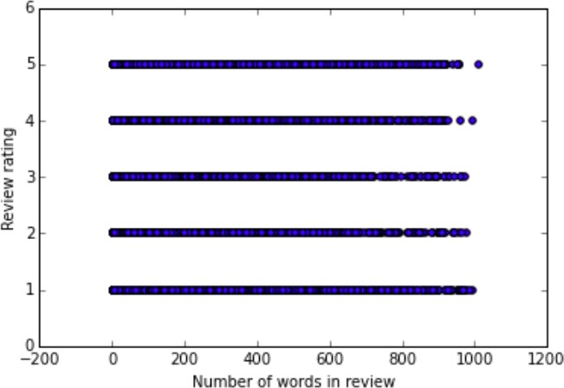
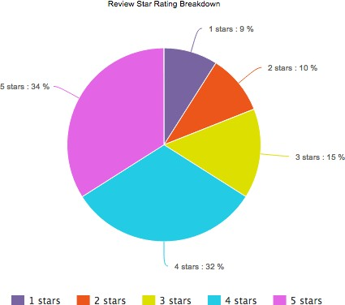
Exploratory Data Analysis
Review:
The yelp reviews dataset consists of ratings provided by the user out of 5 stars.
Most of the users have given ratings more positive ratings to the restaurants.

Slide 9
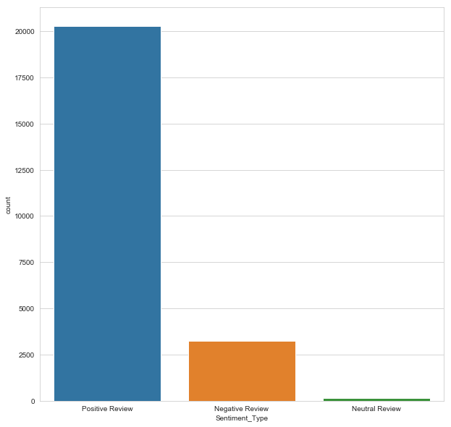
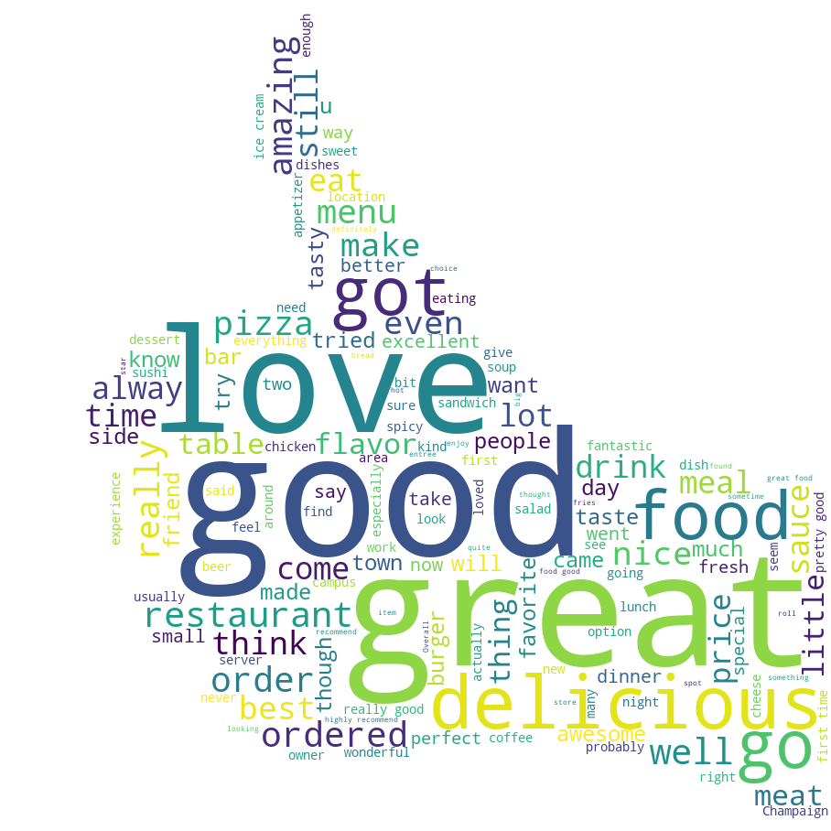
Exploratory Data Analysis

Slide 10
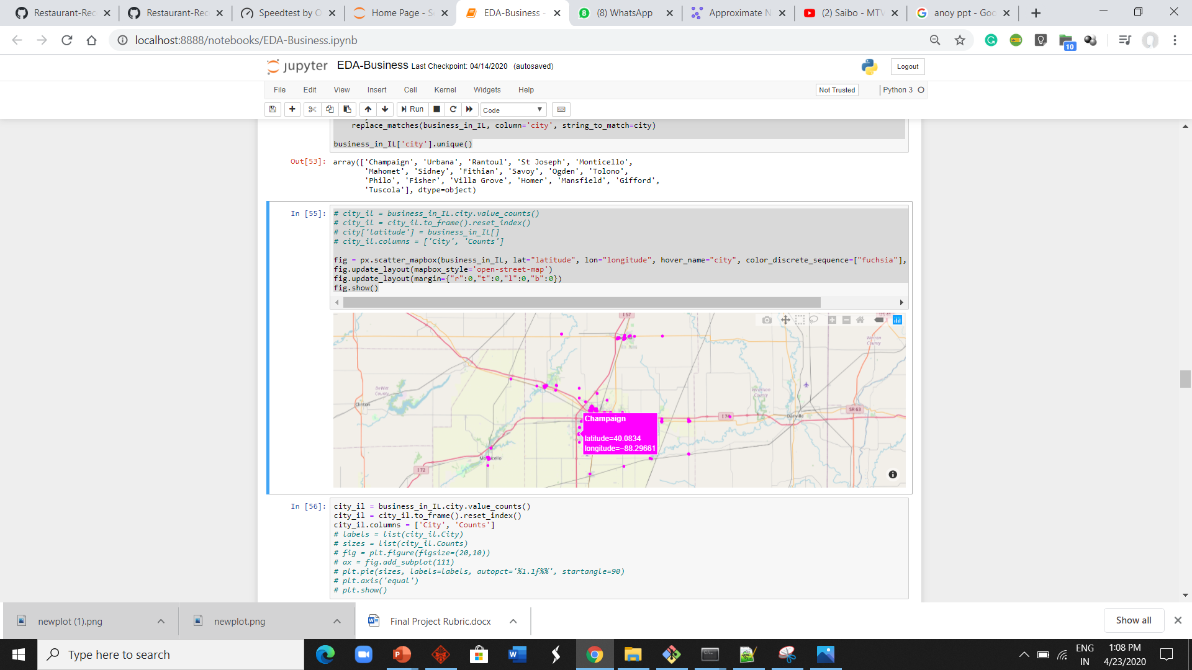
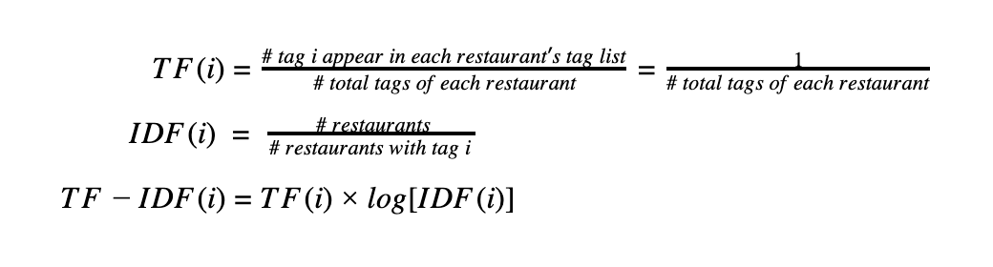
Data Preparation
Business
Businesses with open = 1 tag were only considered
Considered only Illinois-based restaurants in our dataset
Features considered for the recommender system :-
Number of stars
Review counts of each restaurant
Categories of the restaurants as item features
Out of 436 tags we decided to keep top 60 tags with highest popularities
‘Attributes’ column in the dataset was extrapolated to create new features
Computed TF-IDF for each tag which will be used as weights during model fitting
We have incorporated the median income for each zip code from the secondary dataset

Slide 11
Data Preparation
Review
To remove user biases from the ratings provided by the user, we have standardized the users’ rating by subtracting their mean rating, and converting it to [-1,1]
Users
Heuristically we have selected the features from the ‘users’ dataset which are not sparse.
Number of reviews
Number of times the reviews were regarded as useful
Whether the user is active/elite user in Yelp
User’s favorite restaurant category from past interactions
Notes:
Review
The reasoning for this transformation is that we want to focus more on ranking the user liked restaurants and disliked restaurants in the correct order, rather than predicting user ratings on each restaurant, which would result in high variance over time.

Slide 12
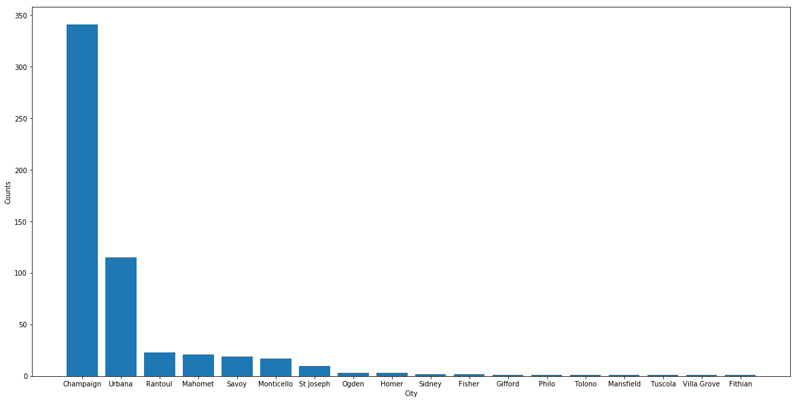
Exploratory Data Analysis
Business: Distribution of restaurant business in Illinois
Notes:
- We cannot state Illinois exploration in eda, we can call it in data preparation after we have declared that we will be focusing on illinois

Slide 13
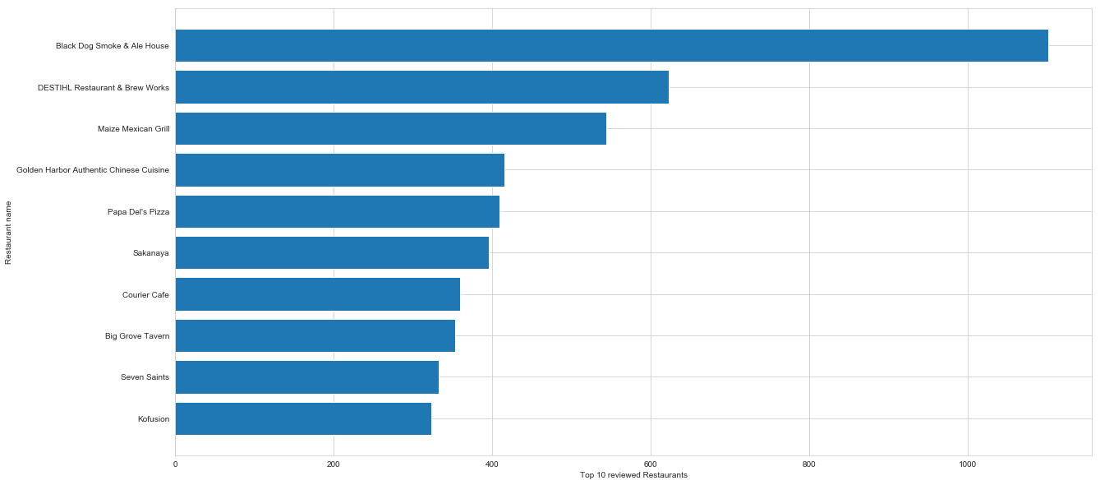
Exploratory Data Analysis
TOP 10 MOST RATED RESTAURANTS IN ILLINOIS
Notes:
- We cannot state Illinois exploration in eda, we can call it in data preparation after we have declared that we will be focusing on illinois

Slide 14
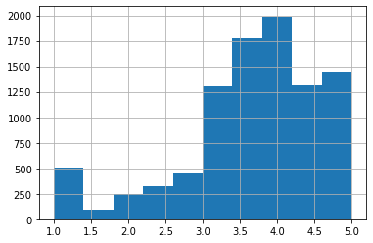
Exploratory Data Analysis
HISTOGRAM OF AVERAGE STARS FOR ILLINOIS USERS

Slide 15
Data Cleaning
1. column value extraction:- Extracted values (such as cuisine type, theme, etc.) from the category column of business data. Since we were creating a recommender system for restaurants in Illinois, we extracted records of restaurants in Illinois only.
2. Null Values:- There were lot of columns with null values, mainly in the columns which were extracted from the category column, so we removed those columns which had null value count more than 300.
3. Duplicate Record:- In Users data, there were lot of users who gave multiple reviews to the same restaurants. For that, we kept the most recent one and removed the others.

Slide 16


Data Cleaning
Business
Spelling Correction for the City variable
Standardize the Date format of Hours variable
Remove redundant Categories
User
Standardize account age by years
Check the missing values

Slide 17
Exploratory Data Analysis
Business: Distribution of businesses in Illinois
The yelp dataset consists of variety of different businesses indicated by the column
Number of entries for the category ‘Restaurants’ was the highest.
Notes:
Mention that ### There are 1301 categories. We shall check top 10 categories.

Slide 18

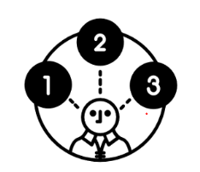
Models
A Recommendation System refers to a system that can predict the future preference of a set of items for a user
restaurant functions.zz
Following are the models which we used:-
Singular Value Decomposition (SVD)
Approximate Nearest Neighbors
Collaborative Filtering
Hybrid Matrix Factorization
Notes:
We aim to build a personalized prototype of restaurant recommendation system, which not only considers the interaction between customers and restaurants, but also contains metadata representing customers' personal taste and
We didn’t use Content based filtering because it doesn’t consider interactions between users and items which can open up new options for users other than it’s past choices.

Slide 19
Models
Approximate Nearest Neighbors:-
Retrieves a ‘good guess” of the nearest neighbor. For that, the algorithm doesn’t guarantee to return the actual nearest neighbor in every case, in order to improve speed or save memory.
An approximate nearest neighbor search algorithm can return points, whose distance from the query is at most c times the distance from the query to its nearest points.
Pros
Option to tune hyperparameters to change the accuracy/speed trade-off.
It has small memory usage
 | AUC | Precision
Train | 0.908 | 0.1806
Test | 0.797 | 0.0114
Cons
It does not support GPU processing.
Notes:
We have used manhathan disatance as we have high dimensional data
[20:52, 23/04/2020] Rahul Illinois Tech: If you want to place less emphasis on outliers, manhattan distance will try to reduce all errors equally since the gradient has constant magnitude.[20:55, 23/04/2020] Rahul Illinois Tech: The use of Manhattan distance depends a lot on the kind of co-ordinate system that your dataset is using.
While Euclidean distance gives the shortest or minimum distance between two points, Manhattan has specific implementations.For example, if we were to use a Chess dataset, the use of Manhattan distance is more appropriate than Euclidean distance.
Another use would be when are interested in knowing the distance between houses which are few blocks apart.Also, you might want to consider Manhattan distance if the input variables are not similar in type (such as age, gender, height, etc.).
Due to the curse of dimensionality, we know that Euclidean distance becomes a poor choice as the number of dimensions increases.
So in a nutshell: Manhattan distance generally works only if the points are arranged in the form of a grid and the problem which we are working on gives more priority to the distance between the points only along with the grids, but not the geometric distance.

Slide 20
Models
Hybrid Matrix Factorization:-
Hybrid recommender is an advanced kind of recommender that uses both collaborative and content-based filtering for making recommendations.
Hybrid matrix factorization model represents users and items as linear combinations of their content features’ latent factors.
Pros
Hybrid matrix factorization model represents users and items as linear combinations of their content features’ latent factors
Able to Handle sparse data.
The model outperforms both collaborative and content-based models in cold-start or sparse interaction data scenarios.
 | AUC | Precision
Train | 0.976 | 0.119
Test | 0.880 | 0.056
Cons
Increased processing time
Overfitting

Slide 21
Models
Collaborative Filtering:-
Collaborative filtering incorporates matrix factorization and looks at user/item interactions (visits)and tries to find similarities among the users and items.
Since it sees the interaction between users and items, it opens up new options for users to select from unlike content-based filtering.
Pros:-
Checks user/item interaction matrix and helps finds new options for users unlike content based which recommends on the basis of user’s past history.
No domain knowledge necessary as the embeddings are automatically learned.
Cons:-
Cannot handle new items
Suffers from sparse interaction matrix between users and items.

Slide 22
Models
KNN:-

Slide 23
Models
But what if it is a new user?
New users would make the deployed model face “cold start” problem in which the user-item interaction matrix which the model use doesn’t have any data for the new user
In this case, we created a different matrix factorization model using the user and item features and then get the new user’s parsed through which checks for its similarity with existing user and then recommends restaurants.

Slide 24
Model

Slide 25
Results

Slide 26
Results

Slide 27
Lessons Learned
How recommendation systems works
Web Scraping
Data Cleaning is not easy
Extracting insights from data

Slide 28
Future Plans
Location based recommendations
Expand the system for the entire country
Build a complete website for the system
Take user inputs and update the database

